Slide 1
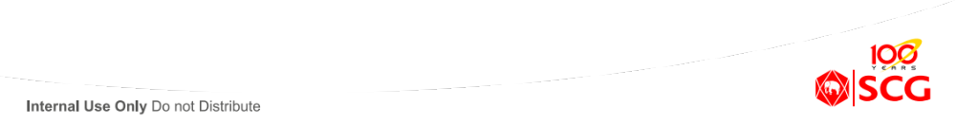
PP101
Introduction to Pulp Making
Made By
Pisan Chitphanthanakorn
Technical Development, SPEC
Werawit Klangboonserm
Engineering Dep, SCG Paper
22nd – 23rd JAN 2015
© SPEC (SCGP Excellence Training Center Co.,Ltd.), 2014
Internal use only – Do not distribute

Slide 2
Topics
1. Introduction to Pulp industry
2. Characteristic of wood and wood pulp
3. Wood and chip handling
4. Overview of Pulping methodology
5. Bleaching sequences
6. Principle of chemical recovery
7. Properties and Testing of pulp

Slide 3
1. Introduction to Pulp industry

Slide 4
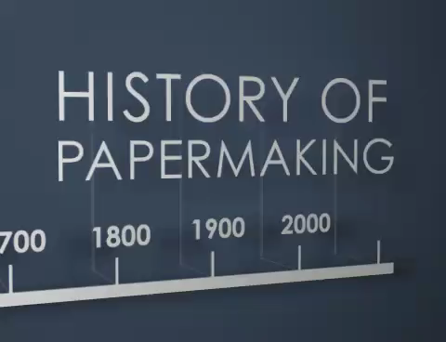
1. Introduction to Pulp industry

Slide 5
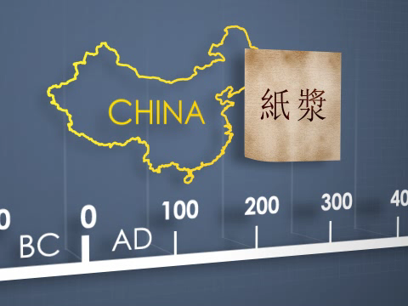
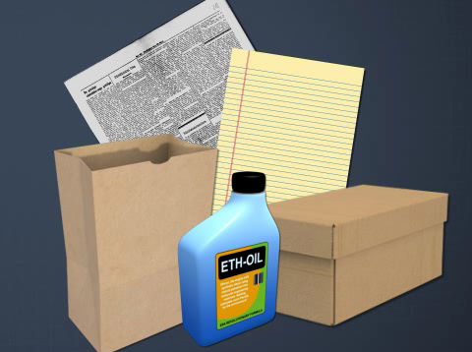
1. Introduction to Pulp industry
The papermaking process was first documented in China over 1900 years ago, and for many centuries, paper was used primarily as a writing surface.
Credit: Convergence Training
Today, thousands of different products are made partially or entirely from paper. From the fuel, oil, and air filters in your car, to the paper money in your wallet, to the roofing paper under the shingles on your home, paper is everywhere.

Slide 6
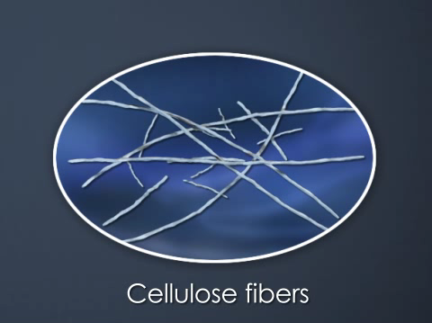
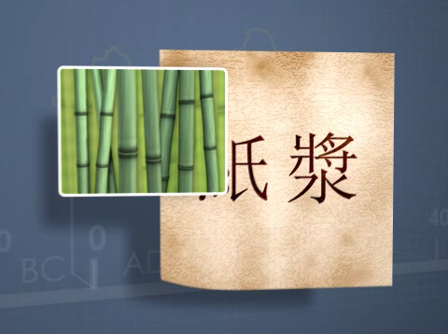
1. Introduction to Pulp industry
Paper is made mostly from cellulose fibers, but the source of those fibers has changed over time.
The first paper made in China was made by hand from bamboo or mulberry bark fibers.
Credit: Convergence Training

Slide 7
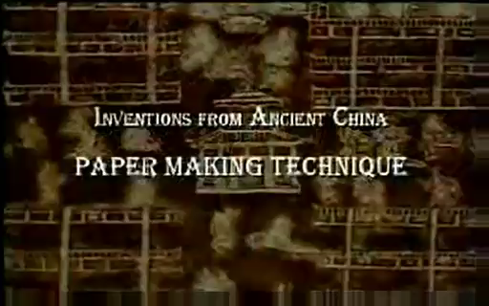
1. Introduction to Pulp industry

Slide 8
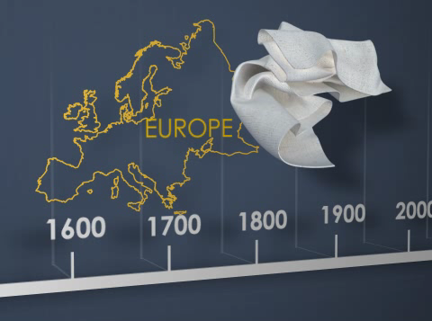
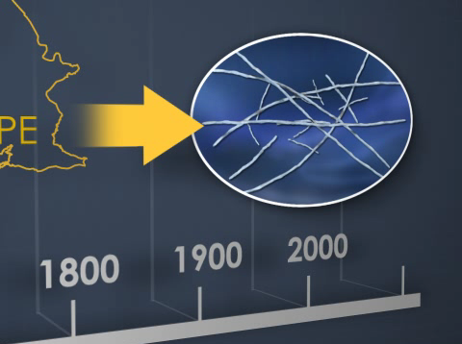
1. Introduction to Pulp industry
When the first continuous paper machines were developed in Europe 300 years ago, cotton rags were the main fiber source, though they were soon in short supply.
This led to the search for a new source of papermaking fibers.
Credit: Convergence Training

Slide 9
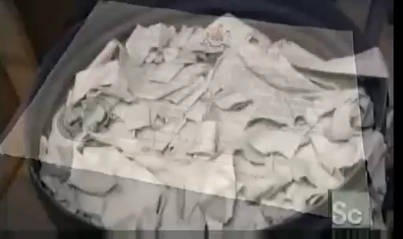
1. Introduction to Pulp industry

Slide 10

1. Introduction to Pulp industry

Slide 11
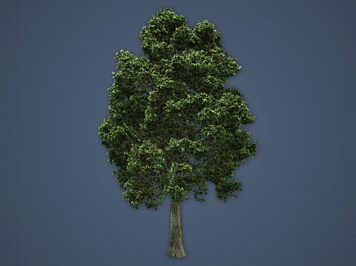
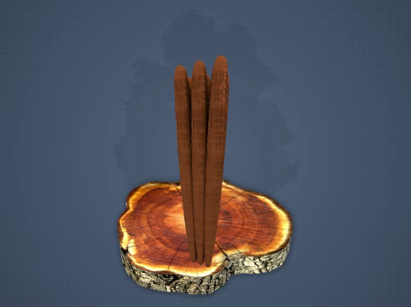
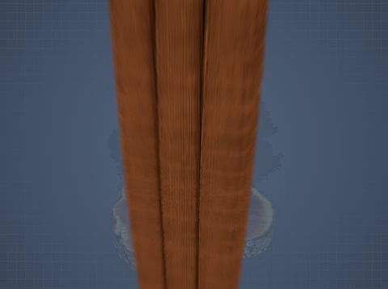
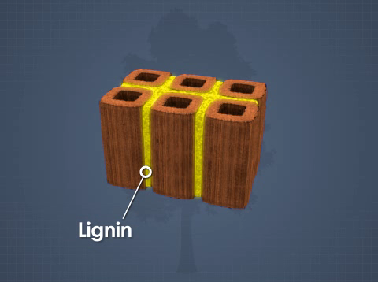
1. Introduction to Pulp industry
Wood is made up of cellulose fibers held together by a naturally-occurring, chemical compound called lignin.
Credit: Convergence Training

Slide 12
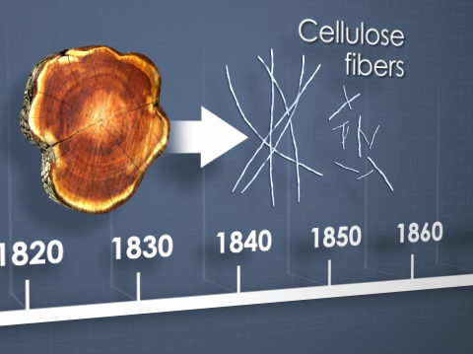
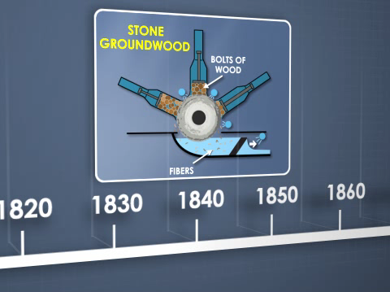
1. Introduction to Pulp industry
In the mid-1800's, several wood pulping processes were invented and a seemingly endless supply of cellulose fibers became available for papermaking.
Wood fibers were first separated from each other mechanically in the stone groundwood process in 1840,
Credit: Convergence Training

Slide 13
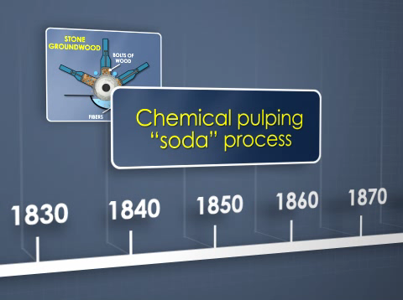
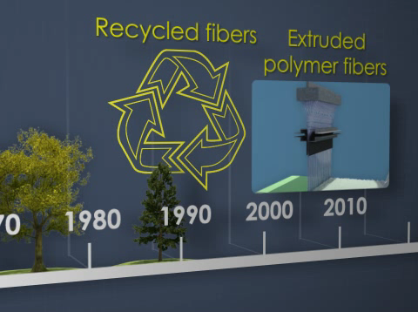
1. Introduction to Pulp industry
the first chemical pulping process, the soda process, was invented in 1851. The kraft chemical process, currently the most popular pulping process, was invented in 1884.
More recently, as wood has become increasingly scarce, paper producers have incorporated recycled fibers into their products. Also, nonwovens made from extruded polymer fibers have taken over some of paper's market share.
Credit: Convergence Training

Slide 14
2. Characteristic of wood and wood pulp

Slide 15

2. Characteristic of wood and wood pulp

Slide 16
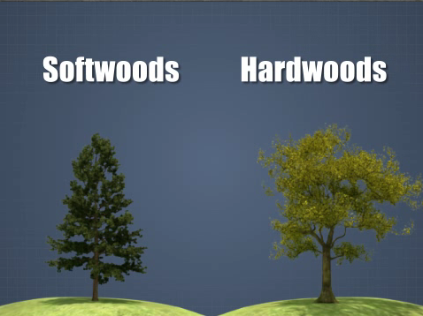
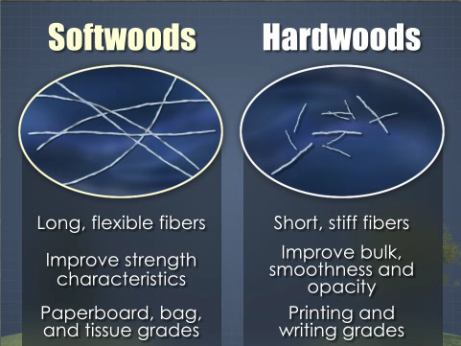
2. Characteristic of wood and wood pulp
The two main classifications of trees - softwoods and hardwoods - contain fibers that are physically quite different from each other.
In general, hardwood fibers tend to be short and stiff, which contribute to the bulk, smoothness, and opacity of paper. Therefore, they are often used in printing and writing grades. Softwood fibers tend to be long and flexible, which contribute to the strength characteristics of paper. They are used in paperboard, bag, and tissue grades.
Credit: Convergence Training

Slide 17

2. Characteristic of wood and wood pulp

Slide 18
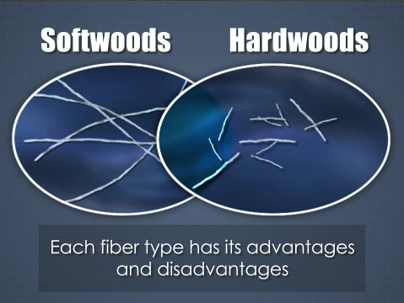
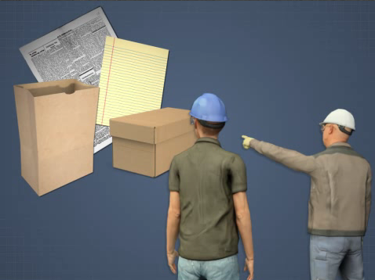
2. Characteristic of wood and wood pulp
It should be noted that fiber characteristics vary widely even within the softwood and hardwood classifications, and there is some overlap. Each fiber type has its advantages and disadvantages. In the end,
the choice of which wood fibers, or which blend of fibers, to use in the papermaking process depends on the grade of paper being produced and its end-use requirements. Fortunately, all wood fibers are structurally and chemically similar, so they can be pulped and made into paper by the same basic processes.
Credit: Convergence Training

Slide 19
2. Characteristic of wood and wood pulp
Chemical components of wood
21 % HW
25 % SW
WOOD
2-8 %
LIGNIN
EXTRACTIVES
CARBOHYDRATES
Terpines
Resin acid (SW)
Fatty acid
Phenol
Unsaponifiable
35 % HW
25 % SW
45 %
CELLULOSE
HEMICELLULOSE
Glucose
Glucose
Mannose Galactose
Xylose Arabinose
Credit: Suebthip Pongpaiboon

Slide 20
2. Characteristic of wood and wood pulp
SOFTWOODS
HARDWOODS
42+2 %
45+2 %
Cellulose
Long-chain unbranched molecules
Skeletal Polysaccharides
27+2 %
Hemicellulose
Branched short-chain molecules
Matrix Polysaccharides
30+5 %
28+3 %
Lignin
Three-dimentional phenolic
polymer network
20+4 %
3+2 %
Extractives
5+3 %
Figure 1.1 Average compositions of softwoods and hardwoods
Credit: Suebthip Pongpaiboon

Slide 21
2. Characteristic of wood and wood pulp
WOOD AGE
Wood properties are affected by wood age ….
INCREASING AGE…
- Log size Increase
- Density Increase
- Fiber length Increase
Shrinkage
- Longitudinal Decrease
- Radial Increase
- Tangential Increase
- Spiral grain Increase
- Resin pockets Increase
- Heartwood Increase
- Moisture Decrease
- Extractive Increase
Did you know?: Most of Eucalyptus species in Thailand is Camaldulensis
The most suitable wood age is 4 years
Credit: Suebthip Pongpaiboon

Slide 22
3. Wood and chip handling sequences

Slide 23
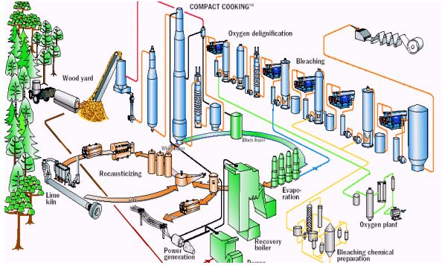
3. Wood and chip handling
Ref: http://www.tappsa.co.za/archive2/APPW_2004/Title2004/Applying_best_sustainable_prac/2004-27fig1a.jpg

Slide 24
3. Wood and chip handling
Ref: http://www.tappsa.co.za/archive2/APPW_2004/Title2004/Applying_best_sustainable_prac/2004-27fig1a.jpg

Slide 25
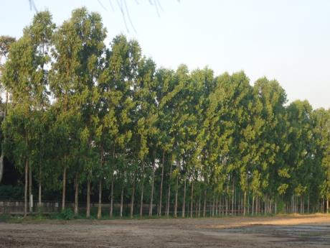
ยูคาลิปตัส
วัตถุดิบใช้ผลิตเยื่อ

Slide 26
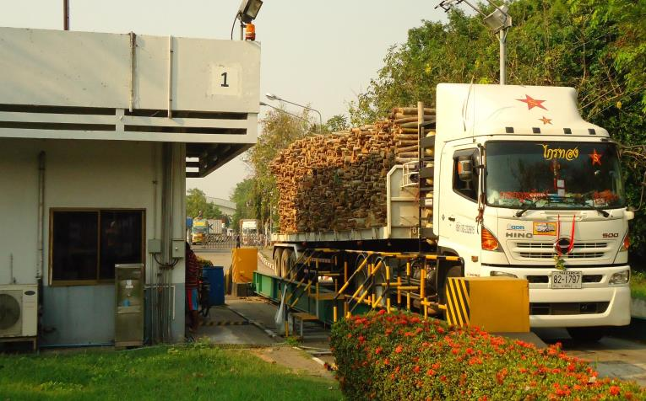
ชั่งน้ำหนัก

Slide 27
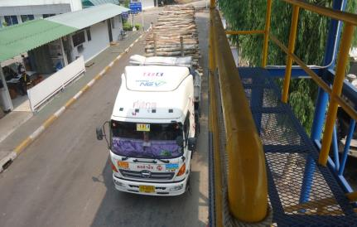
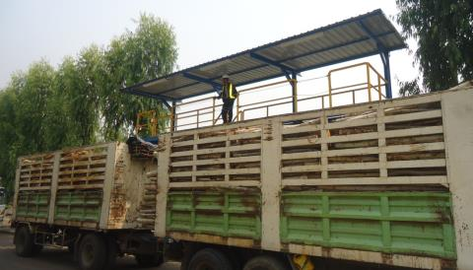
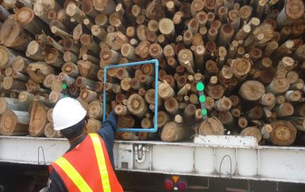
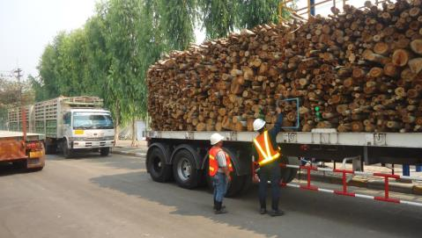
ตรวจไม้ที่จุดตรวจ
ตรวจไม้ด้านบน
ตรวจไม้ที่ท้ายรถ/ด้านข้าง

Slide 28
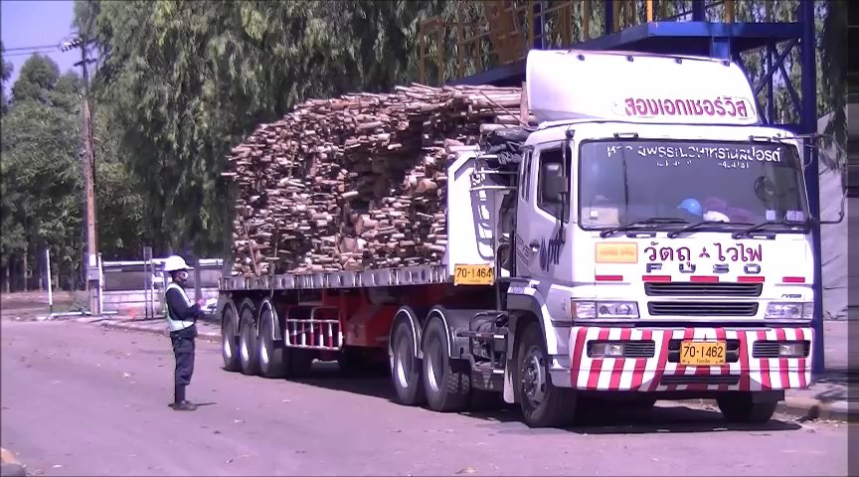
Video การตรวจรับไม้

Slide 29
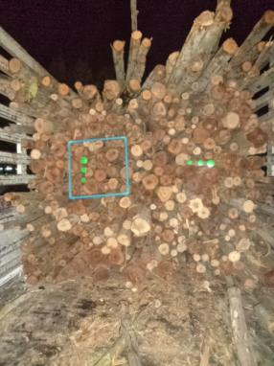
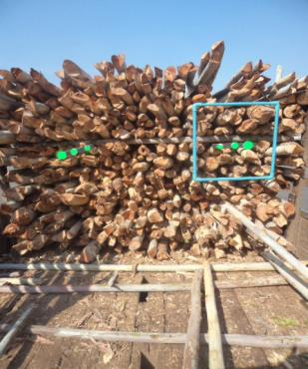
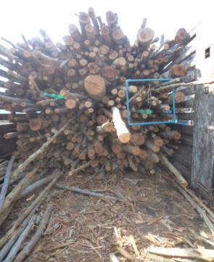
สุ่มตรวจไม้ในขณะป้อนไม้เข้าเครื่องลอกเปลือก

Slide 30
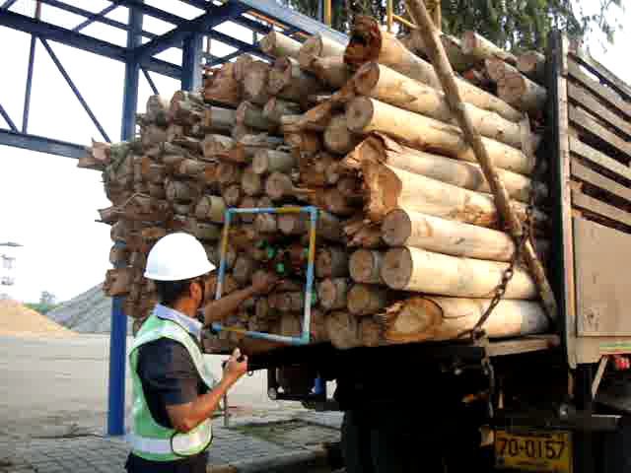
Video วิธีหาค่า Index ไม้

Slide 31
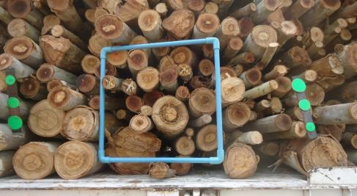
LOG INDEX
// = > 2.0”
X = > 2.5”
= > 3.0” ขึ้นไป

Slide 32
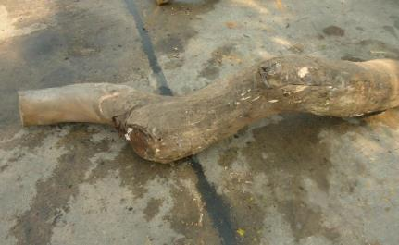
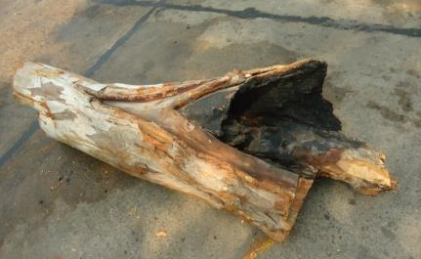
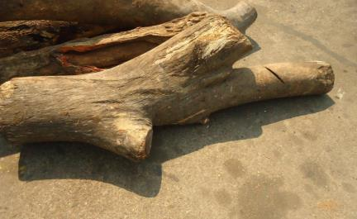
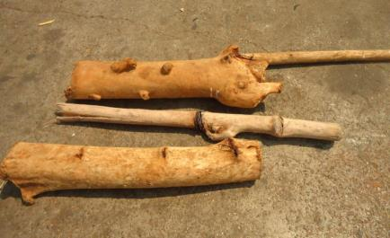
ไม้ยูคาลิปตัสที่เราไม่ต้องการ
ไม้คดงอ
ไม้ไฟไหม้
ไม้เป็นง่าม
ไม้มีลวด ,ตะปู

Slide 33
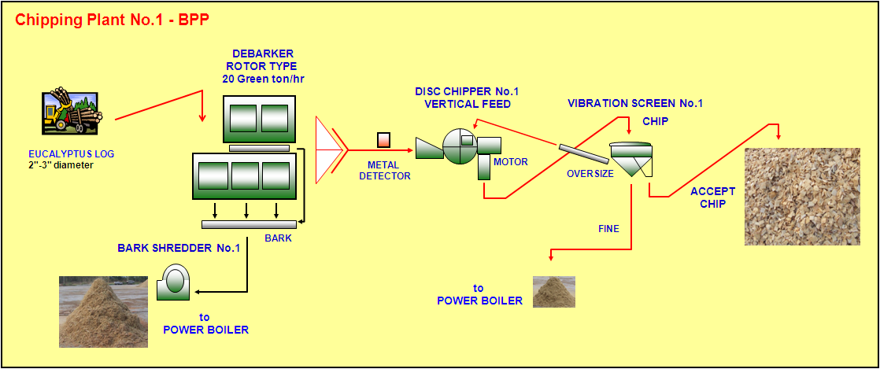
3. Wood and chip handling
Debarking
process
Chips classifying
Logs feeding
Chipping
process
Chip storage
Barks
shredding
Credit: Weerachai Seachao

Slide 34
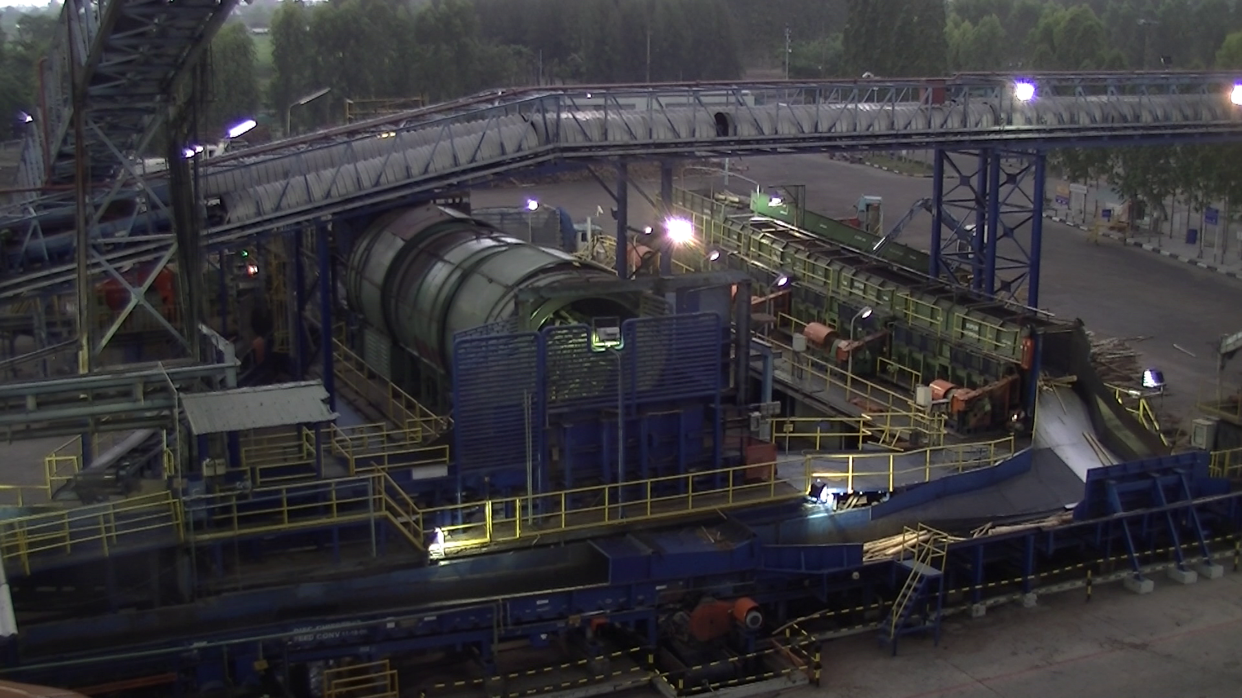
Debarking Process : remove bark
Super Barker
Debarking Drum

Slide 35
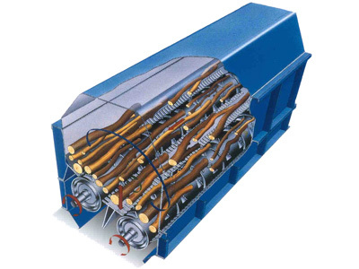

Debarking Process : remove bark
1) Rotary Drum Debarker
Use gravity and weight of log
Log itself to break the bark out
of wood log skin. Suitable for
Std.Log diameter = > 3 inch
Log diameter = > 2.0 inch

Slide 36
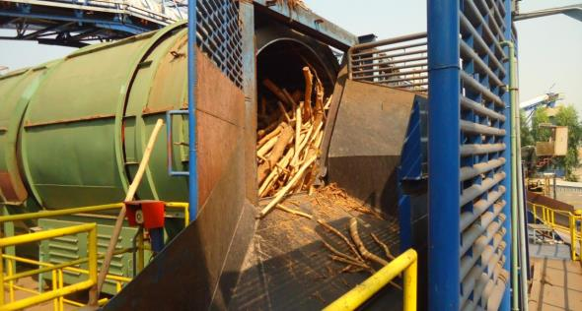
Debarking Dum

Slide 37
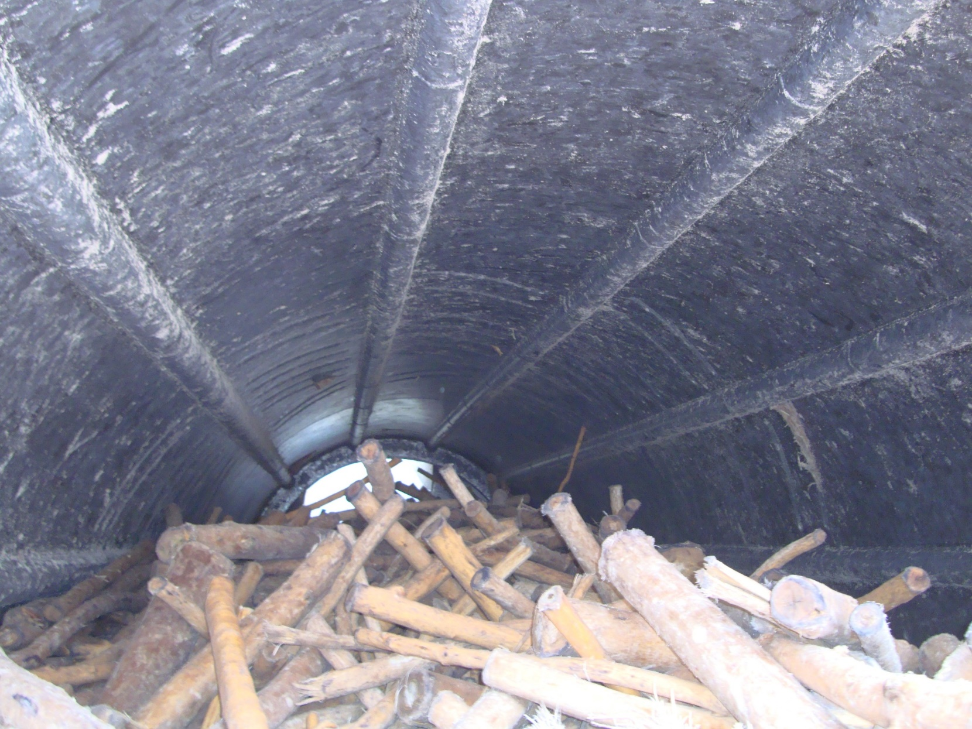
ลักษณะภายใน Debarking Drum

Slide 38
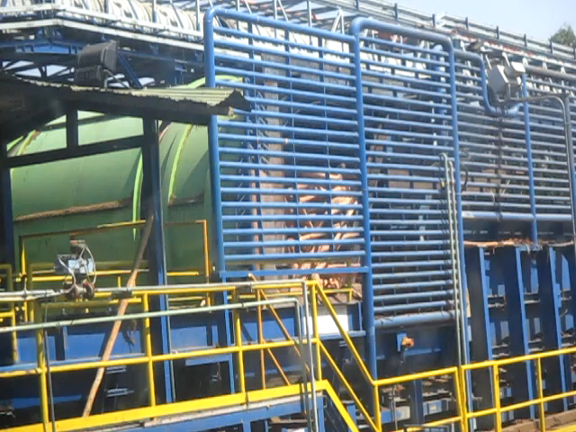
Video การทำงาน Debarking Drum

Slide 39
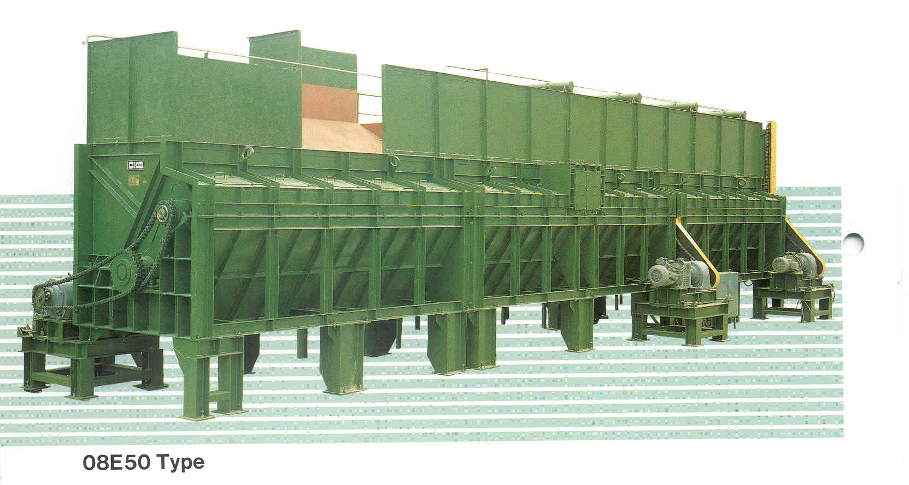
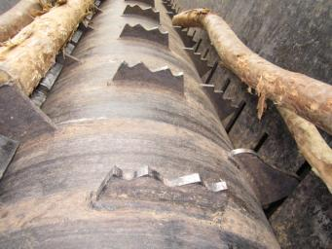
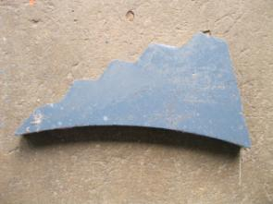
Debarking Process : remove bark
2) Mechanical Debarker
Use mechanical energy drive comb
Shredder to take out the bark from
wood log skin. Suitable for
Std.Log diameter = < 3 inch
Super Bark
Log diameter = > 1.5 inch

Slide 40
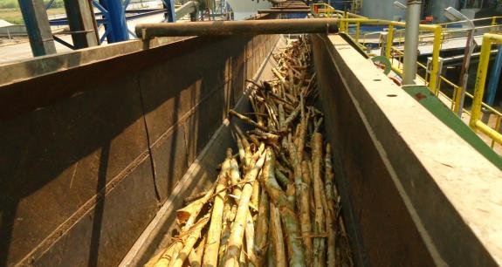
ลักษณะภายใน Super barker

Slide 41
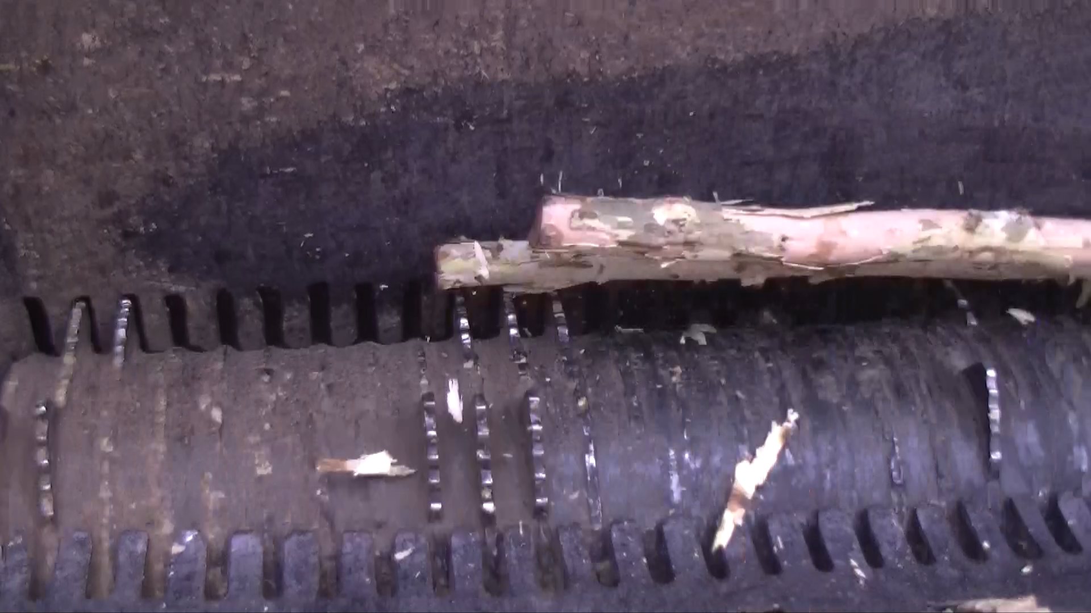
Video การทำงาน Super Barker

Slide 42

ตัวอย่างไม้ยูคาลิปตัสที่ผ่านการลอกเปลือกออกแล้ว
ยังไม่ได้ลอกเปลือก
ลอกเปลือกแล้ว

Slide 43

BARK

Slide 44
3. Wood and chip handling
Debarking
process
Chips classifying
Logs feeding
Chipping
process
Chip storage
Barks
shredding
Credit: Weerachai Seachao

Slide 45





3. Wood and chip handling
Chipping Process: Make Chip
1) Drum Chipper
Drum rolling with a long knife
to chop the log in to small chip
Adv: Can handle big log, tough
Disadv: Consume more energy,
High maintenance cost,
2) Disc Chipper
Rotating Disc with a set of shorter knives. The disc rotate to chop the log into chips
Adv: Lower power, Lower manintenance cost
Disadv: less tough than Drum

Slide 46

Metal Detector
What is it for?

Slide 47

3. Wood and chip handling
Bark Handling: Make bark
Bark Shredder: use drum chipper to make bark size smaller

Slide 48


Machine Specification
Disc
Chipper
Disc Chipper #1
Gravity Feed
Manufacturer :
“Nicholson”
No. of Knife : 8 Pcs.
Disc RPM : 420 rpm.
Disc Dia. : 2200 mm.
Motor : 2x315 kW.
Disc Chipper #2
Horizontal Feed
Manufacturer :
“Kone Wood”
No. of Knife : 16 Pcs.
Disc RPM 400 rpm.
Disc Dia. : 2200 mm.
Motor : 770 kW.

Slide 49
Disc Chipper

Slide 50

ลักษณะภายใน Disc Chipper

Slide 51

Video การทำงาน Disc Chipper

Slide 52

Chip Eucalyptus

Slide 53
3. Wood and chip handling
Debarking
process
Chips classifying
Logs feeding
Chipping
process
Chip storage
Barks
shredding
Credit: Weerachai Seachao

Slide 54



CHIP SCREEN (Vibration Screen)

Slide 55


3. Wood and chip handling
Chip Classifying: Classify Chip Size
Vibration Screen:
Chip is convey to the top of Vibration screen that vibrate the acceptable chip size will fall down through the series of screens until reach the bottom conveyor to Chip Silo or deliver to Chip Yard. The oversize remain on the screen and fall down on the discharge chute.
Did you know?: Evenly chip size can help process stability

Slide 56

Chip Screen (Vibration Screen)

Slide 57

CHIP SIZE
WIDTH
LENGTH
THICKNESS

Slide 58

CHIP OVERSIZED

Slide 59

PIN CHIP

Slide 60

FINES

Slide 61


Chip Classification Lab
เป็นการสุ่มตรวจคุณภาพ Chip
ว่าได้ตามมาตรฐานหรือไม่
โดยการสุ่มตัวอย่าง Chip จาก
Disc Chipper เพื่อมาค้นหา
ว่าได้ปริมาณ Chip ตามมาตรฐาน
หรือไม่ หากมี Oversize หรือ Fine
เกินกว่ามาตรฐานแสดงว่า ใบมีดนั้น
เสื่อมคุณภาพและต้องวางแผนเปลี่ยน
ตามลำดับ

Slide 62
Chip Quality
CHIP CLASSIFICATION
SAMPLING DATE: |  |  | 12 ก.พ.56
TYPE OF CHIPS: |  |  | Eucalyptus
SAMPLING POSITION: |  |  | SPPC
 |  |  | 2120.99 |  | g. (ASIS)
HOLE ON |  | WEIGHT OF FRACTION |  |  | % FRACTION | % STD. FRACTION
HOLE 45 mm. |  |  | 31.96 |  | 1.51 | max. 1% | Oversize
SLOT 8 mm. |  |  | 214.24 |  | 10.10 | - | Overthick
SLOT 6 mm. |  |  | 347.24 |  | 16.37 | -
SLOT 4 mm. |  |  | 662.82 |  | 31.25 | - | Accept
HOLE 7 mm. |  |  | 799.64 |  | 37.70 | -
HOLE 3 mm. |  |  | 52.73 |  | 2.49 | max. 4% | Pin chip
DUST |  |  | 5.83 |  | 0.27 | -
BARK |  |  | 6.53 |  | 0.31 | max. 0.7%
TOTAL ACCEPT FRACTION |  |  |  |  | 85.32 | min. 85%
BULK DENSITY: |  | VOLUME OF CHIPS: |  |  | - | M³
 |  | WET WEIGHT: |  |  | - | Kg
 |  | DRY WEIGHT: |  |  | - | Kg
 |  | MOISTURE CONTENT: |  |  | - | %
 |  | BULK DENSITY: |  |  | - | Kg/M³
DISTRIBUTION CURVE
% FRACTION

Slide 63

ลานกองเก็บ Wood Chip

Slide 64

คลุมผ้าใบกอง CHIP

Slide 65

Chip จากลานกองเก็บส่งเข้า Chip Silo

Slide 66



CHIP SILO
Chip Silo is use for storing chip that is ready to for cooking in the Digester. It use chip discharge screw to distribute the chip via a belt conveyor to convey chip continuously and constantly to the Chip Bin. The speed can be adjust due to the capacity demand
SCL Chip Silo
Chip Discharge Screw
Chip Discharging

Slide 67


3. Wood and chip handling
Chip Storage/Chip Yard: to store chip / chip aging
SCL Chip Yard
Chip
This is where the chips are store and feed to Cooking process. There are 2 purpose of chip storage:
To create chip inventory in case that log are in short supply
To improve the Chip properties, this apply to tropical climate country. The moisture in chip are evaporate which make it suck chemical easily at cooking stage
Chip aging is a number of days the chip is keeping on the Chip yard. It is normally keep for 20 – 45 days before cooking. If keep it longer the chip will be very dry which will effect to the cooking parameter

Slide 68
4. Overview of Pulping methodology

Slide 69

4. Overview of Pulping methodology

Slide 70



4. Overview of Pulping methodology
Today, the manufacture of pulp and paper from wood involves three major operations:
1. Pulping
2. Pulp processing
3. Paper or board production
The first operation, pulping, separates the cellulose fibers in wood from each other by mechanical, chemical, or a combination of mechanical and chemical means.
Credit: Convergence Training

Slide 71
4. Overview of Pulping methodology
Ref: http://www.tappsa.co.za/archive2/APPW_2004/Title2004/Applying_best_sustainable_prac/2004-27fig1a.jpg

Slide 72

4. Overview of Pulping methodology

Slide 73


4. Overview of Pulping methodology
Mechanical pulping processes use water, shear forces, and heat to liberate the fibers in wood, and the pulp that is produced consists of a mix of fibers and fiber fragments.
In the very first mechanical pulping process, called stone groundwood, bolts of wood were pressed up against a large, wet, revolving grindstone.
Credit: Convergence Training

Slide 74



4. Overview of Pulping methodology
Refiner
Refiner
Section
In the 1950's, a new device called a "refiner" was developed. In a refiner, wood chips are shredded and ground up in water, between rotating discs with raised bars on their surfaces. Today, almost all mechanical pulp is produced by refiners.
Credit: Convergence Training

Slide 75


4. Overview of Pulping methodology
Oxidizes
Paper
Because paper made from mechanical pulp contains all of the constituents of the wood, it is called "wood-containing paper." Wood-containing papers, like newsprint, are usually grey in color with high opacity and a smooth surface for printing. One disadvantage of these papers is that they tend to yellow with exposure to air and sunlight because the lignin in the paper darkens as it oxidizes.
Credit: Convergence Training

Slide 76

4. Overview of Pulping methodology

Slide 77


4. Overview of Pulping methodology
Semichemical pulping (SCP) processes use a combination of chemical and mechanical means to separate the fibers in wood. Two examples are:
Neutral sulfite semichemical, or NSSC, process. This process produces unbleached pulp at a relatively high yield.
Credit: Convergence Training

Slide 78


4. Overview of Pulping methodology
"Yield" refers to the dry weight of the pulp produced as a percentage of the original dry wood weight.
NSSC pulp is used primarily to produce corrugating medium for corrugated board.
Credit: Convergence Training

Slide 79


4. Overview of Pulping methodology
Chemicals
+
Steam
Chemithermomechanical pulping, or CTMP, process. In this process, wood chips are pretreated with chemicals and steam before they are refined to improve the strength and brightness of the pulp produced.
CTMP pulp is mostly used in printing and writing grades.
Remarks: There are many other semichemical pulping processes, mostly involving pretreatments and post-treatments in mechanical refining.
Credit: Convergence Training

Slide 80
SCG - SCP Mill
(Semi-Chemical Pulp Mill)

Slide 81

SCP Pulp
ผลิตภัณฑ์ : เยื่อ SCP (BP : 64,000 tpy, WS : 75,000 tpy)
วัตถุดิบ : ชิ้นไม้สับยูคาลิปตัส
กระบวนการผลิต: Green Liquor Semi-Chemical Pulping (70-75% Pulp Yield)
การใช้งาน : ใช้ในการผลิตกระดาษลอนลูกฟูก (CM)
ลูกค้า : SKIC

Slide 82



SCP – Raw Material
ชิ้นไม้สับจาก
ไม้ “ลอก” เปลือก
ชิ้นไม้สับจาก
ไม้ “รวม” เปลือก
Eucalyptus
Leucaena
Acacia
Bamboo
Pin Chips

Slide 83
SCP Process Diagram (Banpong Mill)
Chip Washing (ล้างชิ้นไม้สับ)
Presteaming & Partial Digestion (อุ่นด้วยไอน้ำ และ ต้มย่อยด้วยสารเคมีเพื่อแยกลิกนินออกบางส่วน)
SCREW DRAINER
CHIP EUCALYPTUS
SCRAP SEPARATOR
PRE-STEAMING BIN
IMPREGNATOR
STEAM TO AIR
CHIP SCREW FEEDER
GREEN LIQUOR
Press #1
STEAM
DEFIBRATOR
REFINER
Press #2
HD. TOWER
MC. STAND PIPE
TO PAPER
Mechanical Separation + Pulp Washing (ใช้พลังงานกลบดแยกให้เป็นเส้นใย (เยื่อ) และล้างเยื่อ)
CONFLO REFINER

Slide 84

SCP Process Diagram (Wangsala Mill)

Slide 85

SCP – Chip Washing
ระบบลำเลียง Chips เข้าสู่กระบวนการผลิต

Slide 86




SCP – Chip Washing
แยกหิน / เหล็กออกจาก Chips
ดักหิน (QC)
แยกเศษเหล็กด้วยแม่เหล็กถาวร (ความแรง ~1500 Gauss)
ก้อนหิน
เหล็กเส้น

Slide 87


SCP – Chip Washing
ล้างวัตถุดิบ
1. ลด-แยกสิ่งเจือปน (ของหนัก, เศษ-กากยูคาฯ, ทราย)
2. ทำให้ความชื้นของ Chips สม่ำเสมอ
3. อุ่น Chips ให้ร้อน (อุณหภูมิ ~70-80 c)
Screw Drainer
Chips
แยกของหนัก
Washed Chips
Chip Washer
แยกของขนาดเล็ก
Chip Sump
กากยูคาลิปตัสที่
แยกออก

Slide 88
SCP – Chip Washing
Chips
แยกของหนัก
Washed Chips
แยกของขนาดเล็ก
การควบคุมเครื่องจักร
1. ประสิทธิภาพในการแยกสิ่งเจือปน
2. การแยกน้ำส่วนเกินออกจาก Chips

Slide 89
SCP – Partial Digestion
WASHEDCHIP
1. Pre-steaming
(อุ่น+ไล่อากาศออกจาก Chips ด้วยไอน้ำ)
PRE-STEAMING BIN
IMPREGNATOR
GREEN LIQUOR + WHITE LIQUOR
CHIP SCREW FEEDER
2. Partial Digestion
(ต้มย่อยด้วยสารเคมี)
STEAM
DIGESTER

Slide 90

SCP – Partial Digestion
Pre-steaming (อุ่น + ไล่อากาศออกจาก Chips)
Chips
Steam
(ใช้แรงดันต่ำได้)
Presteaming Bin
Pre-Steaming Bin
อุณหภูมิ (~90-100 c)
ระดับ (Level) ของ Chips (>50%)
ความเร็วรอบของ Discharge Screw

Slide 91




SCP – Partial Digestion
การป้อนสารเคมี
(Green Liquor Na₂CO₃+NaOH)
%Charge (1.3 m3/ADT)
TA (100-110 g (Na₂O)/l
Impregnator Condition
อุณหภูมิ (175c)
เวลา (~30 sec)
Liquor Level (<90%)
(ระดับสารเคมีใน Impregnator)
Chips
Green Liquor
Digester Condition
อุณหภูมิ (175c)
เวลา (~25 min)
% Load Motor
Softened Chips

Slide 92


SCP Refining Process
Atmospheric High Consistency Refining
STEAM
Press #1
REFINER
Press #2
ชิ้นไม้สับที่ผ่านการต้ม
DEFIBRATOR
MC. STAND PIPE
Pressurized
High Consistency Refining
HD. TOWER
CONFLO
REFINER#2
CONFLO
REFINER#1
เยื่อ SCP
Atmospheric Low Consistency Refining

Slide 93



SCP Refining Process
Plate Pattern
Conflo Refiner#1 JC03SF
Defibrator
Refining Zone 2.5-8.5-10
Cutting Length ~10.5 km/rev
Refiner 11979s*
Fine Zone 2-3-6
Middle Zone 2-4-10
Conflo Refiner#2 JC03SF
Refining Zone 2-3-7
Bar Angle 10 mm
Cutting Length 45.7 km/rev

Slide 94
SCP Refining Process
Plate Pattern
Conflo Refiner#1 JC03SF
Defibrator
Refining Zone 2.5-8.5-10
Cutting Length ~10.5 km/rev
ปรับปรุงเป็นรุ่น -2G-SJ
เพิ่มขอบของ Bar ให้สูงขึ้น
ทดลองใช้ New Patturn Design ของ Dura สามารถช่วยลด Load ที่ Swing ได้ (horizontal steaming Tube)
Refiner 11979s*
Fine Zone 2-3-6
Middle Zone 2-4-10
ปรับปรุงเป็นรุ่น -G-JH
เพิ่มความแข็งแรง
เปลี่ยนเป็นรุ่น 11979VT
ปรับ Groove width
Fine zone 2-2.5-6
Middle zone 2-3.5-10
Conflo Refiner#2 JC03SF
Refining Zone 2-3-7
Bar Angle 10 mm
Cutting Length 45.7 km/rev

Slide 95
SCP Refining Process
Refining Parameters
 | Defibrator | Refiner | Conflo#1 | Conflo#2
Type | Single Disc | Single Disc | Conical | Conical
 | Pressurized | Atmospheric/High Consistency | Low Consistency | Low Consistency
Plate Pattern (Bar Width-Groove Width-Bar Height) | 2-8.5-10 | 2-2.5-6 2-3.5-10 | 2-3-7 | 2-3-7
% Pulp Consistency | ~20% | ~30-35% | ~5.0-5.5% | ~5.0-5.5%
SEC (kWh/ADT) | 50-100 | 150-250 | 80-120 | 80-120
Pulp Quality Control | %Shive <70% | Freeness 500-700 ml CSF (Shive <30%) | Freeness 500-530 ml CSF | Freeness 380-430 ml CSF

Slide 96


SCP Refining Process
1st Stage Refiner
Pressurized
High Consistency
2nd Stage Refiner
Atmospheric
High Consistency

Slide 97



SCP Refining Process
Atmospheric
Low Consistency Refiner
(Conflo Refiner; Conical Refiner)
Conflo Segment

Slide 98
SCP
Pulp Characteristics

Slide 99

Pulp Yield vs คุณสมบัติเยื่อ
SCP
Pulp Strength
Pulp Yield

Slide 100

คุณสมบัติเยื่อ SCP
SCL
SCP

Slide 101

คุณสมบัติเยื่อ SCP
SCL
SCP

Slide 102

คุณสมบัติเยื่อ SCP
SCP
SCP

Slide 103

คุณสมบัติเยื่อ SCP vs AOCC vs LOCC

Slide 104






คุณสมบัติเยื่อ SCP vs AOCC vs LOCC
Ring Crush Test (RCT) : The maximum compression force per unit width that a test piece of the paper or board can support until the onset of failure in a compression test
ISO 9895-1989 Unit : N
Testing Machine
Concora Medium Test (CMT) : The maximum compression force per unit width that a test piece of the paper or board can support until the onset of failure in a compression test
ISO 9895-1989 Unit : N
Testing Machine

Slide 105
คุณสมบัติเยื่อ SCP
การใช้งานเยื่อ SCP
กระดาษลอนลูกฟูก (Corrugating Medium)
ชั้นล่าง/ชั้นกลางของ Linerboard
เยื่อ SCP vs เยื่อเศษกระดาษ
Stiffness / CMT / RCT สูงกว่า
ต้นทุนการผลิตต่ำกว่า
ความสะอาดของเยื่อ
การ Drain น้ำบนลวดเดินแผ่นดีกว่า
Tensile, Tear, Stretch ต่ำ
เยื่อมีสีคล้ำ / มีฟอง / เสี้ยน
บดเพิ่มคุณภาพยาก (ใช้พลังงานมากกว่า)

Slide 106





Slide 107

4. Overview of Pulping methodology
Credit: Convergence Training

Slide 108


4. Overview of Pulping methodology
The two major chemical pulping processes are:
• Sulfite
• Kraft, or sulfate
In both processes, wood chips are "cooked" in a chemical solution called "liquor" to remove the lignin and separate the cellulose fibers from each other.
Credit: Convergence Training

Slide 109


4. Overview of Pulping methodology
Because lignin and some other wood components are dissolved and removed, these pulps are referred to as "wood-free."
One major disadvantage of chemical pulping processes is that they have yields in the range of 40 to 50%, whereas mechanical pulping yields run around 95%.
Credit: Convergence Training

Slide 110

4. Overview of Pulping methodology
The main advantages of chemical pulps are that the fibers are longer and stronger, and they can be bleached to a high brightness.
Credit: Convergence Training

Slide 111

4. Overview of Pulping methodology

Slide 112


4. Overview of Pulping methodology
In chemical pulping, the cooking is accomplished in a "digester" (a large pressure cooker), in either a batch or a continuous process.
In the batch process, the digester is loaded with wood chips, filled with cooking liquor, and then heated and pressurized with steam.
Credit: Convergence Training

Slide 113


4. Overview of Pulping methodology
After several hours at these conditions, the liquor-fiber mixture is released or "blown" from the bottom of the digester.
In a continuous digester (Kamyr being the most common name),
Credit: Convergence Training

Slide 114


4. Overview of Pulping methodology
the wood chips and heated cooking liquor are continuously fed into the top, the cooking occurs as they travel through the digester, and the liquor-fiber mixture is continuously blown
from the bottom.
After cooking, the used pulping chemicals and dissolved wood components are washed from the pulp using water. The pulp is directed to the next process step, while the wash water is pumped to the recovery area of the mill
Credit: Convergence Training

Slide 115

4. Overview of Pulping methodology
Credit: Convergence Training

Slide 116


4. Overview of Pulping methodology
The sulfite process uses an acidic cooking solution. Sulfite pulps are easily bleached to remove all of the remaining lignin,
They are currently used to produce tissue, fine paper, and specialty grades.
Credit: Convergence Training

Slide 117


4. Overview of Pulping methodology
One significant specialty grade of highly-bleached sulfite pulp is called "dissolving pulp," which can be used to produce rayon, cellophane, and methylcellulose (a thickener and emulsifier that is used in food and cosmetic products).
One drawback to the sulfite process is that it is sensitive to some wood species; it cannot handle resinous softwoods, dark-colored hardwoods, or bark-contaminated wood.
Credit: Convergence Training

Slide 118

4. Overview of Pulping methodology
Credit: Convergence Training

Slide 119


4. Overview of Pulping methodology
The kraft (or sulfate) process is by far the dominant chemical pulping process. It uses an alkaline cooking solution and has several advantages over the sulfite process, including:
• Handles a wide variety of wood species
• Tolerates bark-contaminated wood chips
• Produces the highest strength pulp
• Has a proven, efficient chemical recovery process
Credit: Convergence Training

Slide 120


4. Overview of Pulping methodology
Unbleached kraft pulp is dark brown in color and is very strong. It is used to produce packaging materials, including corrugated board and paper bags.
Kraft pulp that has been bleached white is commonly used to produce white papers that require strength, including tissue, printing, and packaging grades.
Credit: Convergence Training

Slide 121

4. Overview of Pulping methodology

Slide 122


4. Overview of Pulping methodology
After pulping, the cellulose fibers liberated from the wood may undergo one or more additional processes to prepare them for papermaking. These include:
• Pulp screening to remove contaminants and impurities, such as fiber bundles and small rocks
• Pulp bleaching with chemicals to increase brightness (this will be covered in greater detail on the next page)
Credit: Convergence Training

Slide 123


4. Overview of Pulping methodology
• Pulp refining to make the fibers more pliable and increase the surface area available for bonding; these actions improve the strength characteristics of the paper produced from the fibers
The desired characteristics of the paper being produced dictate the type and amount of processing performed on the pulp fibers.
Credit: Convergence Training

Slide 124
SCG - CP Mill
(Chemical Pulp Mill)
Soda Process

Slide 125








4. Overview of Pulping methodology
SCL Ban Pong Pulp Mill
CHEMICAL PULP PROCESS DIAGRAM
135adt/d, 44,000ADT/Y, Bleached Eucalypts pulp 85+1%ISO
Chip from chipping plant
Own Chip 60%
Chip Purchased 40%
Fresh Water to
Wash
Vibration screen
Oxygen, NaOH
Wash Press
SWL, SMP
Brown Stock Washer
Vacuum type
No.1
No.2
Kappa
inlet 22.0
O2 Reactor
O2 Blow tank
Screw feeder
5 TUBES PANDAI DIGESTER
60min@172C
Knotter no.1
WB to Evaporator
(13-14%)
Knotter no.2
24PS Screen
COOKING PROCESS
SCREENING AND WASHING
OXYGEN DELIGNIFICATION
Unbleached pulp (Kappa no.13-15, BN 35-40%ISO)
Cl2 (g)
BN 45-50%ISO
BN 65-72%ISO
BN 85-87%ISO
BN 85-87%ISO
Dirt + Shive < 3.0ppm
NaOH, H2O2
NaOCl
Pulp Baling
150kgAD
52%Moisture
HD unbleached C-Stage Eop-Stage H-Stage Cleaner stage HD Bleached Pulp Machine (HDP-DWP)
BLEACHINIG PROCESS
Credit: Weerachai Seachao

Slide 126

4. Overview of Pulping methodology
SCL Wangsala Pulp Mill
CHEMICAL PULP PROCESS DIAGRAM
250 adt/d, 65,000ADT/Y, Bleached Eucalypts pulp 85+1%ISO
Credit: Weerachai Seachao

Slide 127


Pulping
What is pulping
Pulping is the process by which wood is reduced to a fibrous mass
It is the means of rupturing the bonds within the wood structure to separate the fibers

Slide 128
Chemical pulping
Operation objective
The objective of chemical pulping is
to remove lignin not only from the fiber
walls but also from The middle lamella so
that the wood fibers can separate.

Slide 129
Chemical pulping
Principle of pulping
Pre-steaming and Impregnation
1.1 Bulk penetration (การแทรกซึม) : เกิดขึ้นในช่วงแรกของชิ้นไม้สับ
ถ้าชิ้นไม้ที่ผ่านการอบแห้งและไล่อากาศแล้ว การแทรกซึมจะดี
1.2 Diffusion (การแพร่กระจ่าย) : เกิดหลังการแทรกซึม โดยอัตราการแพร่
กระจ่ายจะขึ้นกับพื้นที่หน้าตัดของชิ้นไม้สับ และความแตกต่างของความเข้มข้น
ของ chemical
- อุณหภูมิ
- ระยะเวลาการแทรกซึม (check residual alkali)
2. Cooking and Delignification

Slide 130
Chemical pulping
Three Phase Model: Gustafson’s Model
Initial delignification: (Lignin > 22.5%)
Bulk delignification: (2.2% < Lignin < 22.5%)
Residual delignification: (Lignin < 2.2%)

Slide 131

Chemical pulping
Three Phase Model: Gustafson’s Model
จุดที่ควรหยุดการต้มเยื่อ

Slide 132
Chemical pulping
Kraft Pulping Process
Bulk Phase
HS⁻
Degradation
products
OH⁻
convection
convection
Chip Phase
HS⁻
diffusion
diffusion
OH⁻
Degradation
products
Wood Components

Slide 133
Chemical pulping
The Kraft Pulping Recipe
Uniformity of ingredients
Sufficient steaming of chips for complete air removal
Good access of liquor to all chip surfaces
LIQUOR
WOOD
HEAT

Slide 134
Chemical pulping
Factor for cooking
Chip quality
1.1 Chip thickness : ขนาดที่หนาเกินไป การ Impregnation จะไม่สมบูรณ์
1.2 Fine - Pin chip : ทำให้เกิดความต้านทานในการไหลของ Chip และอุดตันที่ Screen
1.3 Chip movement : การเคลื่อนตัวของ Chip ก่อนการต้ม
1.4 Chip bulk density : ส่งผลต่อ Production
1.5 Oversize : เกิดความสูญเสียที่ Screen (Undercook)
2. Alkali Pulping
2.1 Alkali charge (Volume of alkali) : ส่งผลต่อระดับการแยก Lignin (Delignification degree), Pulp yield และคุณสมบัติของเยื่อ
2.2 Alkali concentration : ส่งผลในด้านการควบคุมการ Impregnation และอัตราการแยก Lignin
3. Liquor to Wood ratio (L/W)

Slide 135

Chemical pulping
Factor for cooking
Alkali Charge : optimize should be 10% excess
1.1 Too low : ทำให้เกิด Lignin precipitate
1.2 Too high : เกิดการทำลาย Cellulose

Slide 136

Chemical pulping
Factor for cooking
5. Alkali Concentration

Slide 137

Chemical pulping
Factor for cooking
6. Time and Temperature
Normal should be 150-190ºC
H-Factor control

Slide 138

Chemical pulping
Single Variable Model: H-factor
H-factor: combines temperature and time into a single variable representing the extent of the cooking (Vroom 1957).
The delignification is assumed to be one single reaction.
Rate of delignification

Slide 139



Chemical pulping
Simplify process diagram of kraft process
Chips
White Liquor
NaOH+Na2S
Wash
Water
Lime
CaO
Pulping
Lime
Kiln
Causticization
Pulp
Recovery
Boiler
Lime Mud
CaCO3
Black Liquor
Organic (Lignin)
Inorganic
(Chemical)
Green Liquor
Na2CO3+Na2S
Evaporators

Slide 140
Continuous digester
Unit operation and machinery
Chips
Chips and
Steam
Liquor
Chips
Impregnation
bin
Zone
Steam
Liquor
s
n
Cooking
Pre-steaming
Impregnation
e
e
Zone
r
c
White Liquor
S
High
Liquor
Pressure
Washing
Feeder
Zone
Black Liquor
Blow Line

Slide 141
Continuous digester
Chip pre-steaming and feed system
Chip bin (Vibra bin) (C23)
Chip meter (C24)
Low pressure feeder (LP feeder) (C25)
Steaming vessel (C26)
Chip chute (C29)
High pressure feeder (HP feeder) (C30)
Chip chute circulation pump (C3)
Sand separator (C31)
Inline drainer (C32)
Level tank (C34)
Top circulation pump (C4)
Chip bin
Vibra bin
Chip meter
LP Feeder
Steaming vessel
Chip
chute
HP Feeder

Slide 142

Continuous digester
Chip bin VS Vibra bin
Vibra bin : ตำแหน่งและหน้าที่
Vibra bin อยู่ระหว่าง Chip bin และตัวควบคุมปริมาณการป้อนของชิ้นไม้สับ (Chip meter ) มีหน้าที่ป้อนชิ้นไม้ออก Chip bin ลงสู่ Chip Meter โดยอาศัยการสั่น จากMotor Vibration ขนาด 5 แรงม้า เพื่อให้ชิ้นไม้สับไหลออกจาก chip bin

Slide 143

Continuous digester
Chip bin VS Vibra bin
Motor No.1 runs
continuously while motor
no.2 runs intermittently
with 20s on and 20s off.
LP Steam
Flash steam
from flash cyclone no.2

Slide 144

Continuous digester
Chip meter (C24)
The rotor in chip meter is equipped with 7 pockets, which feed a pre-determined quantity of chip forward per revolution. The rotor rotates clockwise.
Chip meter is equipped With 2 sight glasses to check that the level is correct and steady.

Slide 145


Continuous digester
Chip meter (C24)
Chip meter ติดตั้งอยู่ระหว่าง Chip bin และ Low pressure Feeder มีหน้าที่ในการควบคุมปริมาณการป้อนชิ้นไม้เข้าสู่ cooking plant ซึ่งก็หมายถึงกำลังการผลิต ( capacity ) จะถูกกำหนดการโดยตัว chip meter นี้
โครงสร้างของ chip meter
ตัวป้อนนี้ประกอบด้วยตัว housing และเพลาหมุนเป็นลักษณะ
วงล้อ ( Wheel ) ซึ่งประกอบด้วยช่องป้อน ( pocket ) ซึ่งปริมาตรแน่นอน วงล้อหมุนนี้สามารถปรับรอบการหมุนได้ตั้งแต่ 7 ถึง 21 rpm ซึงจะเป็นตัวควบคุมปริมาณ chip ที่ป้อนเข้า Digester
การทำงาน
ประสิทธิภาพทางด้านปริมาตร หรือความจุของแต่ละ packet
นี้จะขึ้นอยู่กับความเร็วรอบ ของ wheel และคุณภาพของ chip

Slide 146
Continuous digester
Chip meter (C24)
Production calculation
Total volume of chip meter pocket = 0.145 m3
So,
1 wheel = 0.145 m3
If, chip bulk density = b t/m3
So,
1 wheel = 0.145 x b ton (BDT)
If, chip meter run = n rpm
(round/min)
So,
Total BDT CHIP to Digester = 0.145 x b x n x 60 BDT/hr
Example : Speed chip meter 15.7 rpm, chip bulk density 170kg/m3
Solution
Chip flow to digester = 0.145 x 15.7 x 60
= 136.58 m3/hr
= 23.22 bdt/hr

Slide 147

Continuous digester
Low Pressure feeder (C25)
LP feeder ติดตั้งอยู่ระหว่าง chip meter และ Steaming vessel ทำหน้าที่เป็น
ตัวกั้นระหว่าง pressure ที่เป็นความดันบรรยากาศใน Chip Meter และความดันซึ๋งสูงกว่า
ความดันบรรยากาศ ( แต่ยังเป็น low pressure ) ในระบบของ cooking plant

Slide 148

Continuous digester
Low Pressure feeder (C25)
โครงสร้าง
LP-feeder ประกอบด้วยตัว housing และตัวหมุน rotor มีการป้อน Chip เข้าทางด้านบนและออกทางด้านล่าง และจะมีช่องเปิดเพื่อระบายความดันภายใน pocket ( decompression connection ) ที่ค้างมาจาก Steaming vessel ตัว doctor ( แผ่นรองรับการไหลของ chip ) จะติดไว้ที่ทางท่อ inlet เพื่อให้ chip ไหลสู่ pocket ได้สะดวกขึ้น
ตัว rotor จะประกอบด้วย pocket 5 ช่อง แยกกันโดยมีผนังกั้นแนวยาว จุดที่จำเป็นอย่างยิ่งคือ ระยะห่าง clearance ระหว่าง rotor และ housing ควรมีระยะห่างน้อยที่สุด เพื่อลดอัตราการรั่วไหลของความดันจากภายใน Steaming Vessel ด้วยเหตุนี้ตัว housing และ rotor จะถูกออกแบบให้เป็นลักษณะของ taper ตามแนวแกน เพื่อที่จะสามารถปรับระยะห่างภายในนี้ได้โดยการปรับตัว rotor ตามแนวแกนได้เมื่อระยะห่างเพิ่มขึ้น เนื่องจากการสึกกร่อนจากการหมุน
การทำงาน
chip จะตกลงจาก chip meter เข้าทางด้านบนของ LP-feeder ลงสู่ Pocket ซึ่ง rotor จะหมุนด้วย
ความเร็วรอบประมาณ 22 rpm. เมื่อตัว rotor หมุนไปครึ่งรอบ Chipใน pocket นั้น ก็จะตกลงสู่ทางเข้า Steaming vessel ส่วน pocket ตัวที่ว่างที่ส่ง Chip เข้า steaming vessel แล้วจะมีความดันสูงอยู่ เมื่อหมุนกลับมาถึงช่อง
ระบายความดัน ( decompression line ) ความดันก็จะถูกระบายสู่ Chip bin เพื่อลดความดันเป็นความดันบรรยากาศ

Slide 149

Continuous digester
Steaming vessel (C26)
Steaming vessel ติดตั้งอยู่ระหว่าง LP-feeder และ
HP-feeder chip จะถูกให้ความร้อนจากไอน้ำให้อุณหภูมิสูงขึ้น เพื่อ
ไล่อากาศภายในชิ้นไม้ออก ซึ่งในขั้นตอนนี้เป็นขั้นตอนที่เตรียมเพื่อให้
น้ำยาต้มเยื่อ ( Liquor ) ซึมเข้าภายใน เนื้อไม้ง่ายขึ้นในช่วงของการ
impregnation
โครงสร้าง
ตัว Steaming vessel ประกอบด้วย body ซึ่งเป็นลักษณะทรงกระบอกแนวนอนภายในมี screw conveyor ซึ่งถูกยึดด้วย bearing เป็นตัวนำพา chip ที่ผ่านเข้าทางด้านบนที่ปลายข้างหนึ่งของ vessel
การทำงาน
chip จาก LP-feeder จะถูกป้อนผ่านโดยตัว screw conveyor โดยที่ chip จะอยู่ภายในตัว Steaming vessel เป็นเวลาประมาณ 1.5-2 นาที ไอน้ำที่ป้อนเข้าจะเข้าทางด้านล่าง
ผ่านตะแกรงกระจายไอน้ำเพื่อให้อัตราการถ่ายเทความร้อนดีที่สุด รอบการหมุนของ screw จะ set ไว้ประมาณ 6 หรือ 8 rpm.
ขึ้นอยู่กับปริมาณที่ต้องการผลิต

Slide 150
Continuous digester
Steaming vessel (C26)
The steaming vessel is equipped with a conveying screw which transports the chips through the vessel. This takes about 2 minutes. During this period the chips are steamed at a pressure of 1.0-1.3 bar.
Flash steam
from flash cyclone no.1

Slide 151

Continuous digester
Steaming vessel (C26)

Slide 152

Continuous digester
Chip chute (C29)
The chips from steaming vessel fall into chip chute. It is important that the liquor level in the chip chute is correct. Too low level may cause shocks in the top circulation piping and too high level may cause a decrease in HP-feeder efficiency.
If the level in the chip chute is too high alarm The screw in steaming vessel stops and chip feeding also stops.
If the level is too low HP-feeder stops.

Slide 153

Continuous digester
High Pressure feeder (C30)
The HP feeder is equipped has a rotor with 4 through going pockets, each of which feeds forwards twice per revolution. The wells are places around the rotor with an angle of 45º between the openings.
The HP feeder must never be run dry and is therefore interlocking to stop if the level in the chip chute is low.

Slide 154

Continuous digester
High Pressure feeder (C30)
เมื่อ chip ผ่านตัว HP-feeder นี้ ระบบจะถูกเปลี่ยนจากระบบความดันต่ำไปสู่ความดันสูงซึ่งใกล้เคียงกับ
ความดันใน digester น้ำยาต้มเยื่อที่ไหลเวียนใน chip chute ( chip chute circulation liquor ) จะถูกแยกออกจาก
chip จะปั้มให้ไหลเวียนกลับไปยัง Chip chute ในขณะเดียวกัน chip ก็จะถูกน้ำยาต้มเยื่อความดันสูง ( Liquor ) ใน
Top Circulation ผลักดันให้ขึ้นไปสู่ยอดหอ digester
โครงสร้าง
HP-feeder ใช้หลักการของการหมุนของตัว
plug valve ซึ่งประกอบด้วย Packet 2 ชุด แต่ละชุดจะ
วางในแนวตั้งฉากซึ่งกันและกัน โดยออกแบบให้ pocket
ด้านหนึ่ง (แนวตั้ง)อยู่ตรงกับแนวท่อด้าน Low pressure
( chip chute circulation ) ในขณะที่ pocket อีกด้าน
หนึ่ง ( แนวนอน ) จะอยู่ตรงกับแนวท่อด้าน High
pressure (Top circulation) pocket 2 ชุดนี้ถูกออกแบบ
ให้วางทำมุม 45^{๐} ต่อกัน เมื่อปากทางเข้าออกชุดหนึ่งเริ่ม
ปิด อีกชุดหนึ่งจะเริ่มเปิดขณะที่หมุนไป ทำให้ช่องเปิดของ
แต่ละ Line เปิด 100 % ทุกขณะที่ rotor หมุนไป เราสามารถปรับระยะ clearance ระหว่าง rotor และ housing ได้เช่นเดียวกับ LP-feeder เนื่องจากตัวโครงสร้างเป็น taper สามารถควบคุมได้ โดยการปรับตัว rotor เข้าไป

Slide 155

Continuous digester
High Pressure feeder (C30)
การทำงาน
chip ที่อยู่ร่วมกับ Liquor จาก chip
chute circulation จะผ่าน chip chute ลงมา
เข้า HP-feeder ทางด้านบนและเข้าสู่ pocket
ตัวที่อยู่ในตำแหน่งแนวตั้ง Liquor จะผ่านลงสู่ท่อ
ในวงจรหมุนเวียน chip chute circulation ส่วน
chip จะยังคงค้างใน pocket โดยไม่ผ่าน screen
ที่อยู่ด้านล่างของทางออก เมื่อ pocket นี้หมุนไป
1/4 รอบจนอยู่ในแนวนอนตรงกับ Top circulation Liquor ใน Line นี้ ซึ่งมีความดันสูงจะดัน chip
ป้อนขึ้นสู่ Digester

Slide 156

Continuous digester
High Pressure feeder (C30)
Chip to Top Circulation
Chip become to Chip chute
Circulation
Chip to Chip cute
Circulation

Slide 157

Continuous digester
Chip chute circulation (C3)

Slide 158
Continuous digester
Chip chute circulation (C3)
Chip chute filling degree
"Capacity"
Q_{F} = Chip Flow
Q = Chip Chute Circulation Return Flow
Q_{F}
Filling Degree =
Q_{F}
+ Q
3

Slide 159

Continuous digester
Chip chute circulation (C3)
Chip chute circulation
Top circulation

Slide 160
Continuous digester
Cooking part
WL and
Chips In
Impregnation Zone
Extraction
Liquor Out
Counter-current
heating/washing
(start of bulk
White
delignification)
Liquor
Bulk
Delignification
Wash
Water
Counter-current
heating/washing
(residual
delignification)
White
Liquor
Wash Water
Pulp Out

Slide 161

Continuous digester
Cooking part
Controlled Variables
  Outlet kappa
  EA in various sections of digester
  Chip level
Manipulated Variables
  Lower heater temperature
  White liquor charge
  Chip flow rate

Slide 162
Continuous digester
Cooking part
Top separator (C40)
Cooking liquor in Digester
Hi-Heat washing
The cooking zones and circulation
The trim circulation (C6)
Liquor extraction
The wash circulation (C8)
Outlet device (C42)
The flash cyclone
The condensate system

Slide 163
Kraft Pulping
Basic concept for lower Kappa No.
1. Alkali concentration (NaOH and Na2S) should be low in the beginning of
cook and stay consistent during it. High alkali concentration in the beginning
increases cellulose degradation and consumes alkali unnecessarily.
2. Hydrogen sulfide concentration (HS-, forms when Na2S dissolves and reacts
with wood must be as high as possible in the beginning of the cook. Hydrogen
sulfide increases lignin dissolval rate and it doesn't degradate cellulose in the
beginning of cooking like sodium hydroxide does.
3. Dissolved lignin concentration should be as low as possible, especially in
the end of cooking. Dissolved lignin slows delignification reactions. Moreover,
it may repecipitate on fiber surfaces, especially when alkali concentration
reduces too much.
4. Temperature should be low, especially in the beginning of cooking. Low
temperature decreases cellulose degradation. This degradation is especially
strong in the beginning of cooking.

Slide 164

Continuous digester
Continuous cooking development
HARDWOOD

Slide 165

Continuous digester
Alkali profile
Conventional and MCC Cooking

Slide 166

Continuous digester
Conventional & ITC Cooking
HARDWOOD
Concurrent cooking in the
Upper part of the digester is
followed by a countercurrent
zone below The extraction
screen. Cooking combined
with displacement washing
continues in the ITC zone.
Additional white liquor is
charged and heated in the
circulation loops for final
selective cooking to a low
Kappa numbers.

Slide 167

Continuous digester
Kamyr Cooking information
Type of digester Combined steam/liquor phase with
Hi-Heat diffusion washing
Capacity 192 ADMT/24 h in the digester blow line
Target Kappa No. Approx. 19 for Bamboo
Approx. 25 for Eucalyptus
Yield 47.5% in digester blow line with Bamboo
43% in digester blow line with
Eucalyptus Camadulensis
Raw material Bamboo or Eucalyptus
Chip weight 185 kg/m³ BD for Bamboo
160 kg/m³ BD for Eucalyptus
Construction - Cladding
material - Carbon steel
- Duplex
- Carbon steel with overlay welding
Volume 40 m3 Upper cooking zone
76 m3 Lower cooking zone
165 m3 Washing zone

Slide 168

Continuous digester
Top Separator (C40)
The Chips are transported by the top circulation to TOP SEPARATOR (C40) in the digester. This unit is comprised of a screw which rotates inside a strainer surrounded by a cylindrical inner shell.
Between the screw and the strainer there is only a small clearance to keep the strainer free from pin chips and other small projectiles which may plug the screen plate.
There is,however, a larger space between the strainer and the outer cylinder where the liquor, which has been separated from the chips, collects prior to being returned to the HP feeder by pump C4

Slide 169

Continuous digester
Cooking zone
In a single vessel digester the chips and some of the transport liquor drop into the impregnation zone of the digester vessel. Gravity moves the column of wood chips downwards.
Circulation of liquor within the digester begins with extraction through a peripheral screen. The liquor is heated externally in a heat exchanger and returned to the digester center through a central pipe.

Slide 170

Continuous digester
Trim circulation (C6)
The Purpose of the TRIM circulation is to adjust the temperature and alkali charge.
The trim cooking circulation strainers consist of two rings stave type screens with separate headers placed underneath. Sets of time controlled switching valve,KS185 in the trim circulation,continuously switch strainers,at interval of about 90 seconds, so that liquor is extracted from first the upper ring and then the lower ring. This procedure prevents the strainers becoming plugged.

Slide 171

Continuous digester
Trim circulation (C6)
TRIM STRAINER
The C6 circulation liquor is pumped, by pump C6, through the trim circulation and returned to the chip column in the digester, via the central pipe witch discharges just above the trim circulation strainers.
The differential pressure ,d/p, across the upper strainer ring in the trim circulation is measured by PDIA184 and lower strainer ring is measured by PDIA170.
The flow in the trim circulation at normal production,given in lts/min, is approximately 3 times the daily pulp production, given in ADT.

Slide 172

Continuous digester
Liquor Extraction
The extraction strainers consists of two rings of stave type strainers with headers placed underneath.
- 60 % of total liquor through upper ring,adjust with HIC195
- 40% of total liquor through lower ring, adjust with HIC197
The differential pressure ,d/p
- Upper ring : PDIA196
- Lower ring : PDIA217

Slide 173
Continuous digester
Wash circulation (C8)
The wash circulation ,C8, liquor is circulated by pump C8 through heater C48 where it is heated. It is returned to the digester via the central pipe. The amount of LP steam added, is controlled by TRC212
The flow in the wash circulation at normal production,given in lts/min, is approximately 2 times the daily pulp production, given in ADT. The wash circulation flow is set and shown on FI203.

Slide 174

Continuous digester
Flash cyclone (C50, C51)
The temperature of the extraction liquor, which is about 150-160ºC, is lowered in two stages in two cyclones C50 and C51.
Level control
- First flash LIC218
- Second flash LIC237
Pressure range
- First flash 1.0-1.3 bar
- Second flash 0.3-0.5 bar
Steam used :
- First flash to steaming vessel
- Second flash to vibra bin or
condenser system

Slide 175

Continuous digester
Liquor circulation
FRC178
HS191
TI180
TI173
HS179
FRC203
FRC214
C6
HS185
HS185
TI212
HIC215
C12
FRC183
HS195
HS197
C4
FRC163
C3
FRC155
FRC111
C2
C16
FRC198
C8
C1
C20-1
C20-2
C9
FRC219
FRC153
FRC199
FRC220
Wash liquor from washing
21FRC301

Slide 176

Continuous digester
Chip level control
The chip level in digester is recorded on LRA188. Under normal conditions it is maintained in the middle of the top cylindrical section approx. 2 meters below the top separator.
The chip level is also recorded by two mechanical chip level indicators, LR189 and LR190, which are mounted on the wall of top section of vessel.

Slide 177
Continuous digester
Liquor level, Pressure, Temperature control
The liquor level in maintained about 1 m below the chip level and is adjusted with LRC213, which in turn controls flow controller FRC214,HIC215 for the flow of extraction liquor to flash cyclone.
At the top of the digester there is a relief line to the steaming vessel incorporating pressure controller PRCA192, which open if the digester pressure is too high. If the pressure is too low compressed air will be added from compressor C58, PIC193
The temperature at the top of the digester is controlled by TRC173, which in turn controls the flow of medium pressure steam,FRC172, to the top of the digester.

Slide 178
Continuous digester
Hi-Heat Washing
The liquor in the pulp is displaced with weaker wash liquor. The wash liquor is pumped ,by pump C9, into the digester via nozzles at the bottom. The flow of wash liquor to the nozzles is controlled by FRC198 and FRC199
From the bottom of the digester, the displacement liquor flows upwards and displaces the cooking liquor in the pulp.
The cooking liquor is extracted through the extraction strainers to the flash system and on to the evaporator plant.
Optimize temperature of blow pulp = 75-85ºC
(not effect to pulp strength)

Slide 179


Continuous digester
Outlet device (C42)
Rotating outlet device, C42, is mounted in the bottom of the digester. To obtain a uniform pulp quality. The speed of the scrapper is adjustable from 3 – 7.5 rpm.
The pressure difference over outlet device (C42) between the bottom of the digester and the outlet, shown on PDIA207, is a very useful parameter when judging the discharge consistency.
The speed of the scrapper effects both the concentration of the pulp being fed out and the chip level in the digester

Slide 180

Continuous digester
Blow unit (C43)
The blow unit is equipped with blow nozzles and an agitator. The agitator can work as a consistency indicator as amperage of the motor varies with the consistency. The agitator keeps the blow nozzles clean from agglomerated chips
The pulp discharge is controlled by flow control valves FRC219 or FRC220. The parallel FRC219 and FRC220 can be flushed with high pressure liquor via valves HS222 and HO223.

Slide 181

PULP SCREENING process

Slide 182



PULP SCREENING process

Slide 183

Screening Control

Slide 184

Effect of reject rate on screening Efficiency

Slide 185
Screen Plate Parameters
Screen Size
Screen Pattern – Slot / Hole
Slot / Hole Size
Opening area , %
Profile

Slide 186


Screen plate pattern designs
Hole / Slot / Bar Profile

Slide 187


Screen plate pattern designs

Slide 188


Screen plate pattern designs
SLOT TYPE
BAR TYPE

Slide 189


A Basic Guide to Open Area for SCREEN
Plate/Cylinder Selection
OPENING AREA Example :
Primary screen
Knotter

Slide 190


Slide 191


Slide 192


Slide 193


Slide 194

PULP WASHING process and control

Slide 195
PULP WASHING process and control

Slide 196
Topic outlines
1. Objectives of pulp washing
2. Principles of pulp washing
3. Washing equipments
4. Multi-stage counter-current washing
5. Washing parameters and efficiency

Slide 197
Pulp washing Objective
The purpose of brown stock washing is to displace and remove dissolved solids (both inorganic and organic) from the pulp. The two primary reasons why we must wash pulp are :
1. Remove residual liquor which would contaminate pulp
pulp going to Bleaching process
2. Recover the maximum amount of spent cooking
chemicals and dissolved wood solids from the fiber
with minimum dilution, making chemical pulping
economical.
Alkali, Black Liquor
Chemical recovery, Bleaching

Slide 198
Topic outlines
1. Objectives of pulp washing
2. Principles of pulp washing
3. Washing equipments
4. Multi-stage counter-current washing
5. Washing parameters and efficiency

Slide 199
WASHING MECHANISMS
Washing - Simply bulk removal of liquor surrounding the
pulp fibers.
Leaching - Dissolved solids & Chemicals interior of the
pulp fibers diffuse into the surrounding liquor
before they can be removed.
WASHING OPERATION
1. Displacement washing
2. Dilution/Extraction washing

Slide 200

Principle of displacement washing

Slide 201

Principle of dilution/extraction washing

